Slide 1
Realm + React Native

Slide 2
Database on the App
When you develop the app, at one point, you will need to store information permanently for an application.
For faster loading time or for caching purpose
Example: Facebook app use a local database to record all of the previously loaded news feed.
Types:
AsyncStorage
Database storage

Slide 3

AsyncStorage
AsyncStorage is a simple, unencrypted, asynchronous, persistent, key-value storage system that is global to the app.
On iOS, AsyncStorage is backed by native code that stores small values in a serialized dictionary and larger values in separate files.
On Android, AsyncStorage will use either RocksDB or SQLite based on what is available.

Slide 4

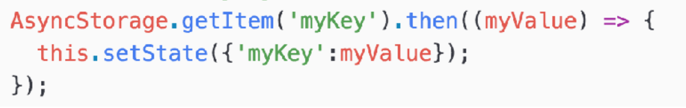
How to use it
Don’t need to installation any extra library. It comes with React-Native by default.
Since loading data is a time consuming task, it is designed to be a asynchronous operation. So getItem returned the promise, which will invoke the call back function when the read operation is completed.

Slide 5

For more complex data
AsyncStorage is just a key-value pair storage
In practical application, we need to store complex information much more than key-value pair.
What if we want the database that can query, search, and support encryption with data modeling?
is the answer!

Slide 6

Realm Database
A flexible platform for creating offline-first, reactive mobile apps effortlessly.

Slide 7
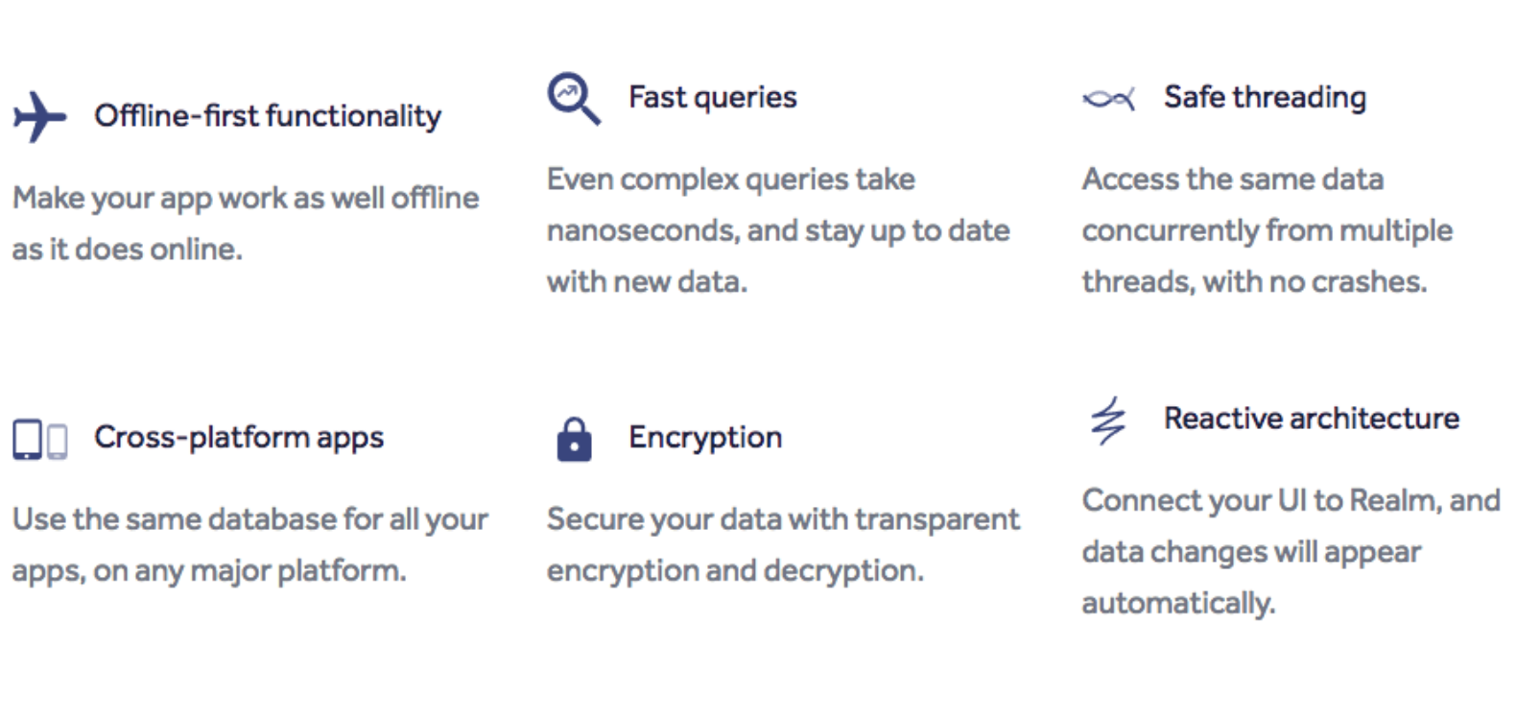
Realm Benefits

Slide 8
Realm Installation
Change directories into the new project (cd ) and add the realm dependency
npm install --save realm
Next use react-native to link your project to the realm native module.
react-native link realm

Slide 9
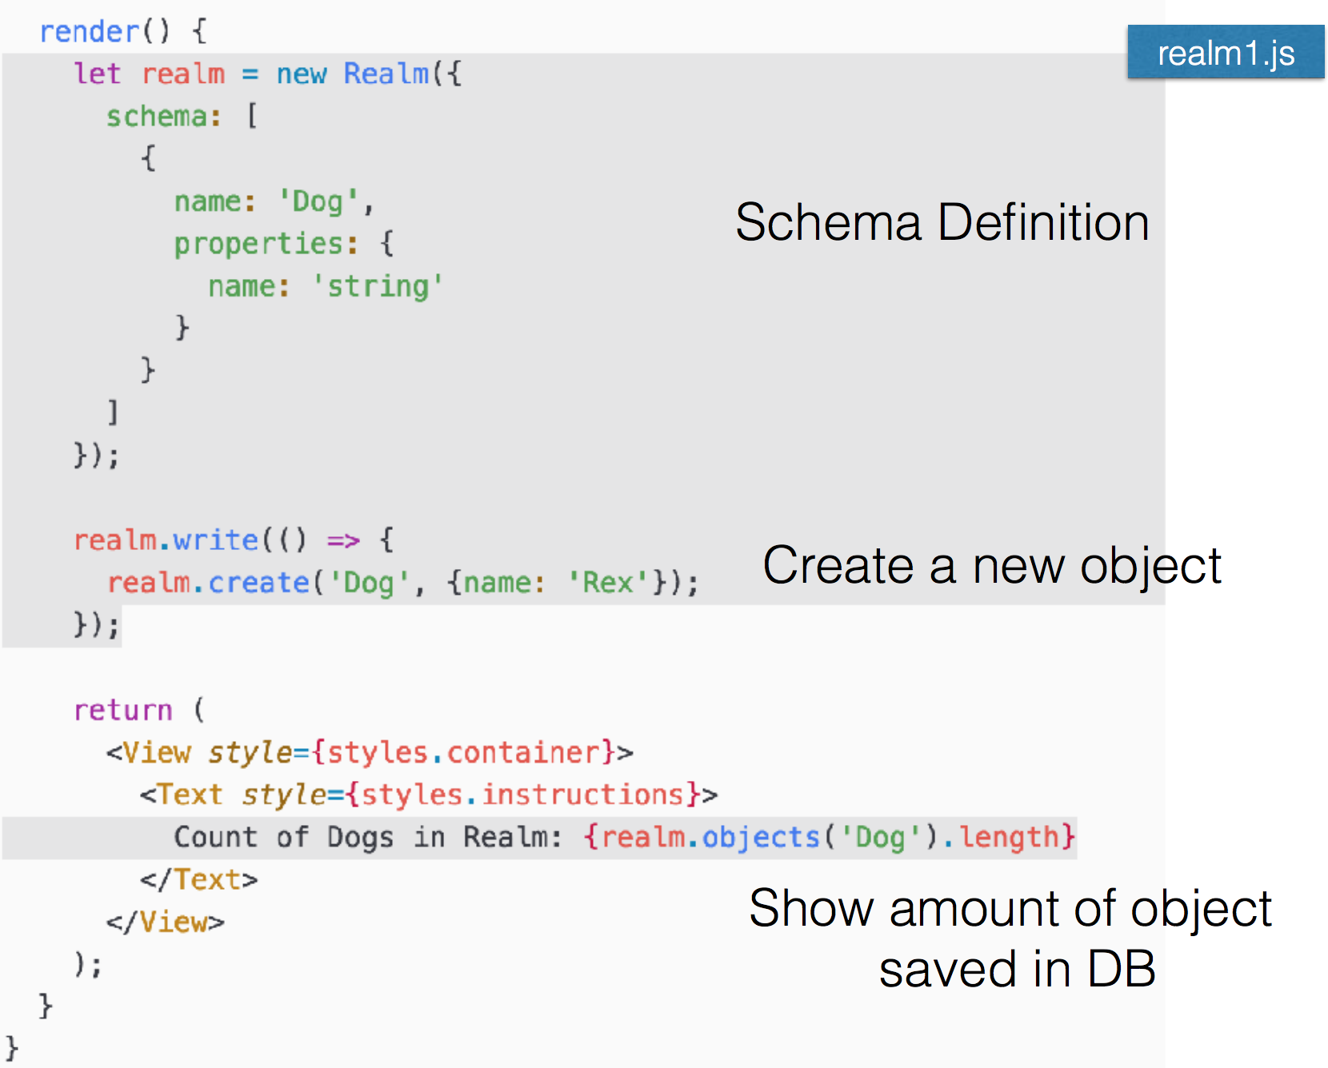
Sample code

Slide 10
Realm Database model
Realm data models are defined by the schema information passed into a Realm during initialization.
The schema for an object consists of the object’s name and a set of properties each of which has a name and type as well as the objectType for object and list properties.
We can also designate each property to be optional or to have a default value.

Slide 11
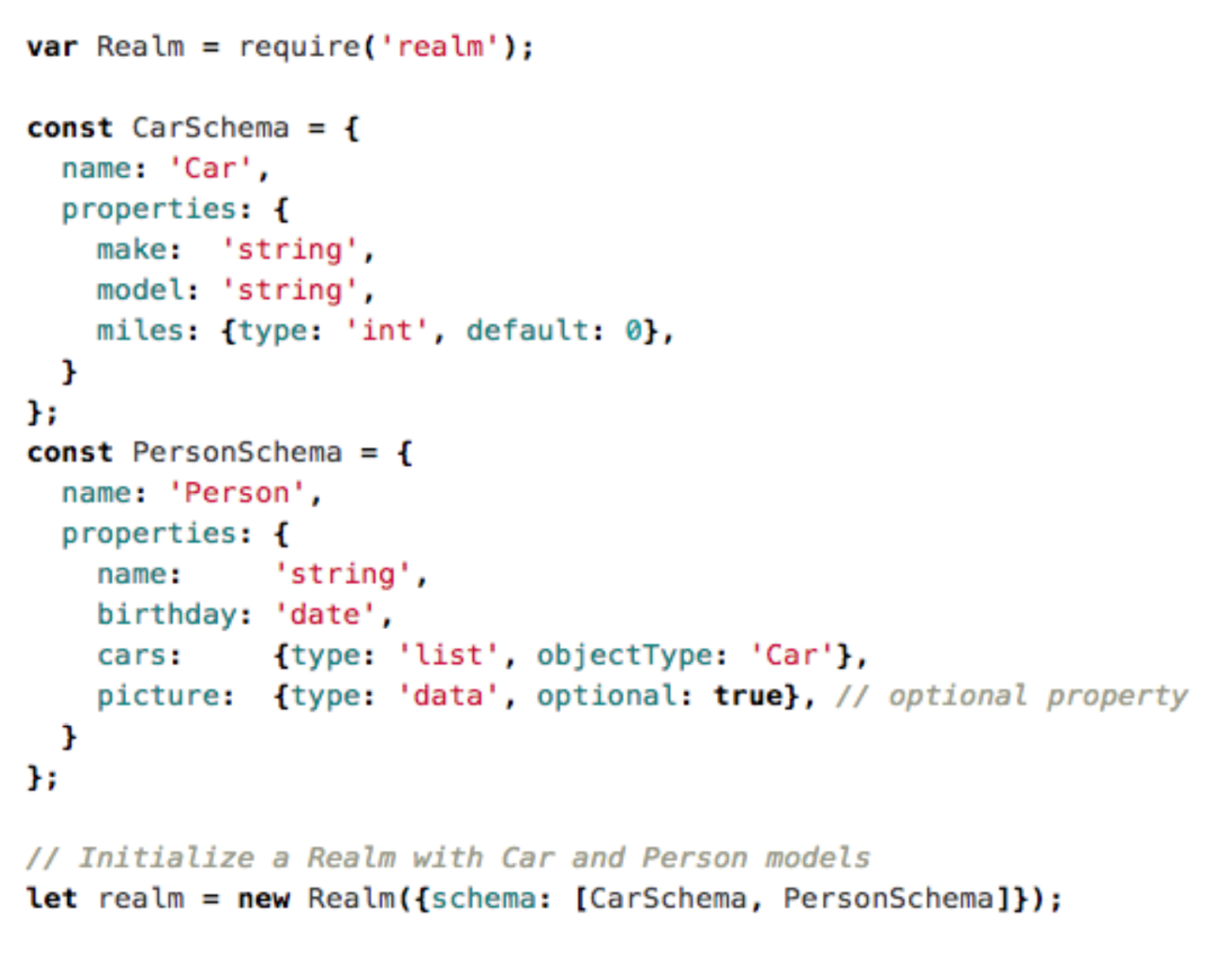
Sample code

Slide 12
Realm basic property type
Realm supports the following basic types: bool, int, float, double, string, data, and date.
bool properties map to JavaScript Boolean objects
int, float, and double properties map to JavaScript Number objects. Internally ‘int’ and ‘double’ are stored as 64 bits while float is stored with 32 bits.
string properties map to String
data properties map to ArrayBuffer
date properties map to Date

Slide 13
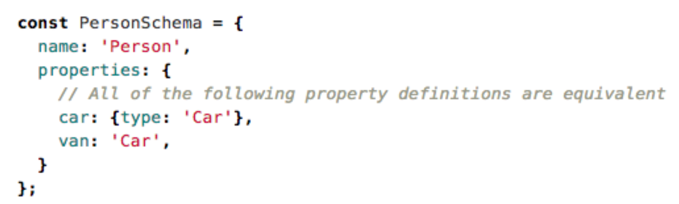
Object properties
To define the new object, we need to specify the name property of the object schema we are referencing.
When using object properties you need to make sure all referenced types are present in the schema used to open the Realm

Slide 14
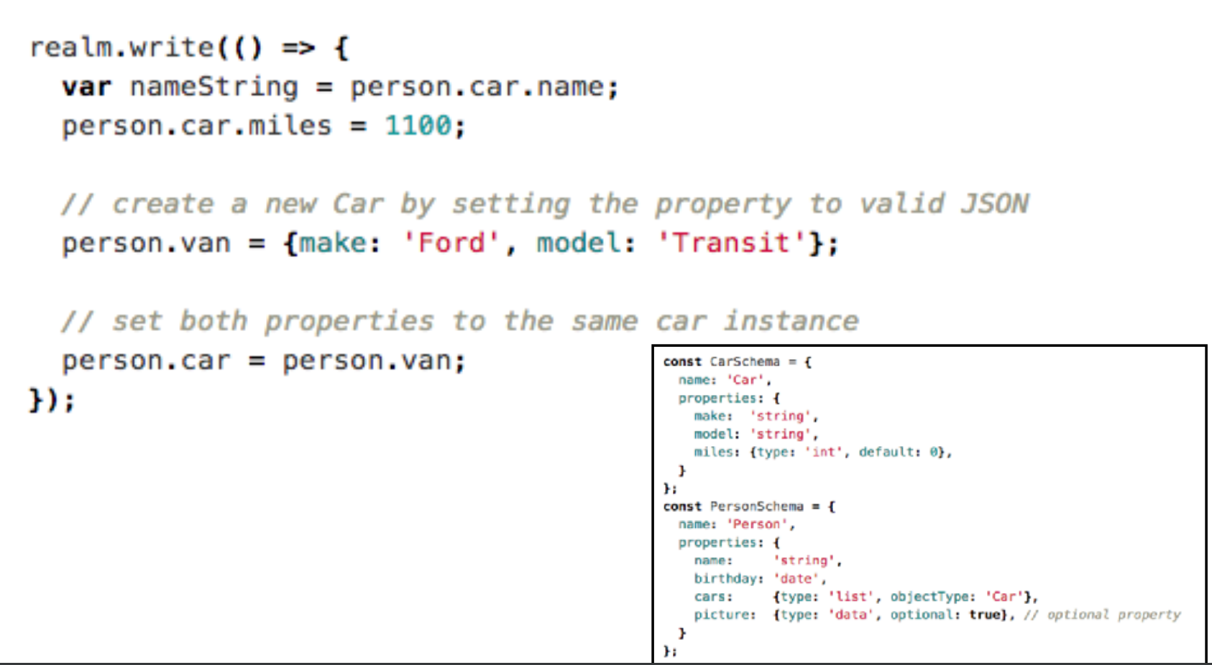
Accessing Object properties
When accessing object properties, you can access nested properties using normal property syntax

Slide 15
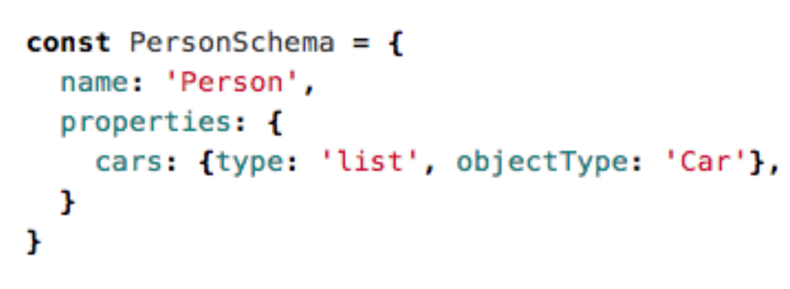
List properties
For list properties you must specify the property type as list as well as the objectType

Slide 16
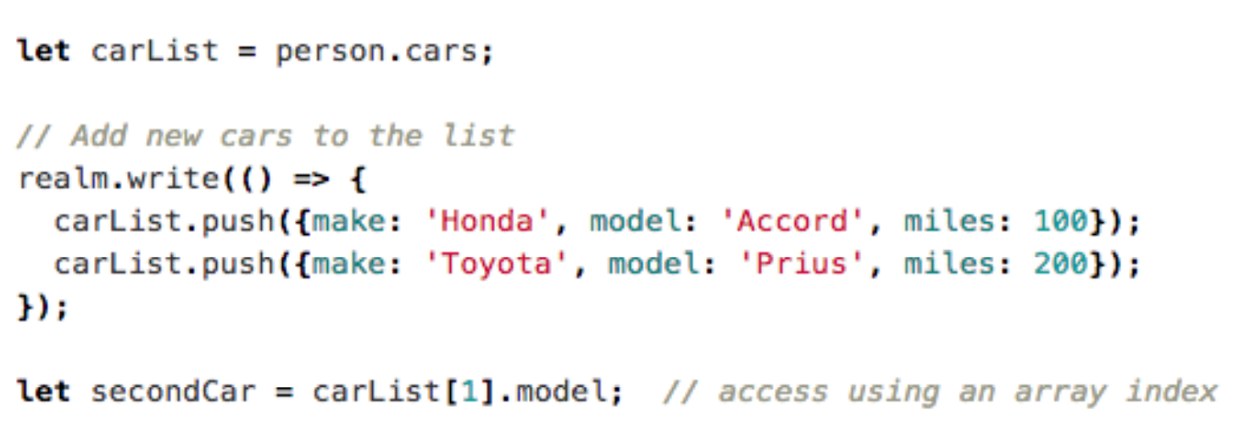
Accessing list properties
When accessing list properties a List object is returned.
List has methods very similar to a regular JavaScript array. The big difference is that any changes made to a List are automatically persisted to the underlying Realm.

Slide 17
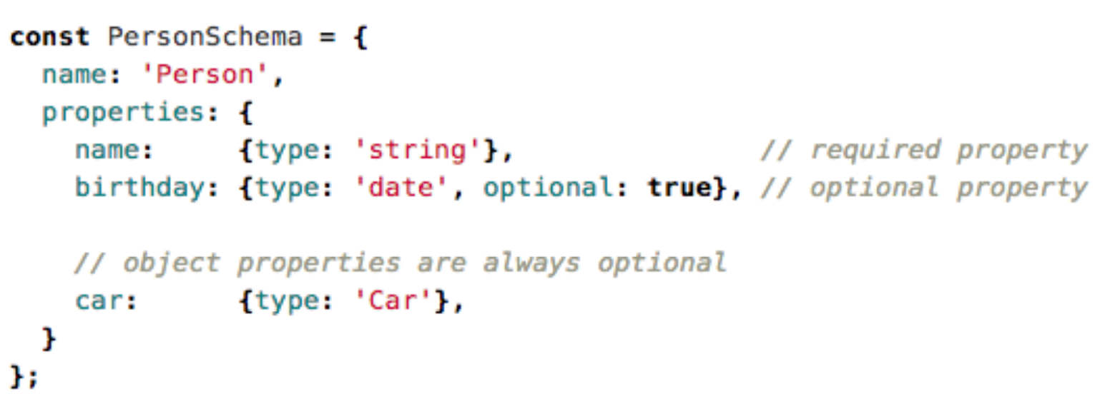
Optional Properties
Properties can be declared as optional or nonoptional by specifying the optional designator in your property definition

Slide 18
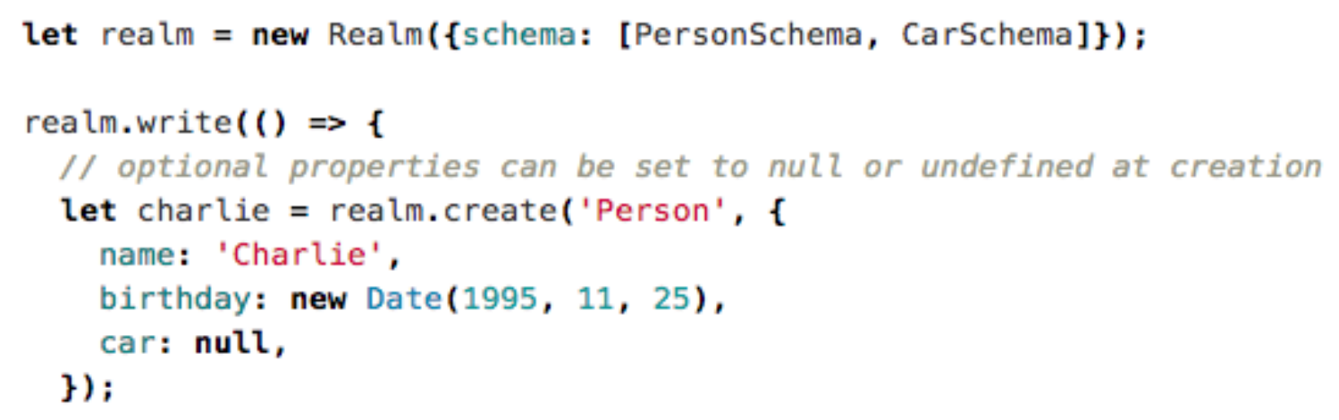
Setting optional properties

Slide 19
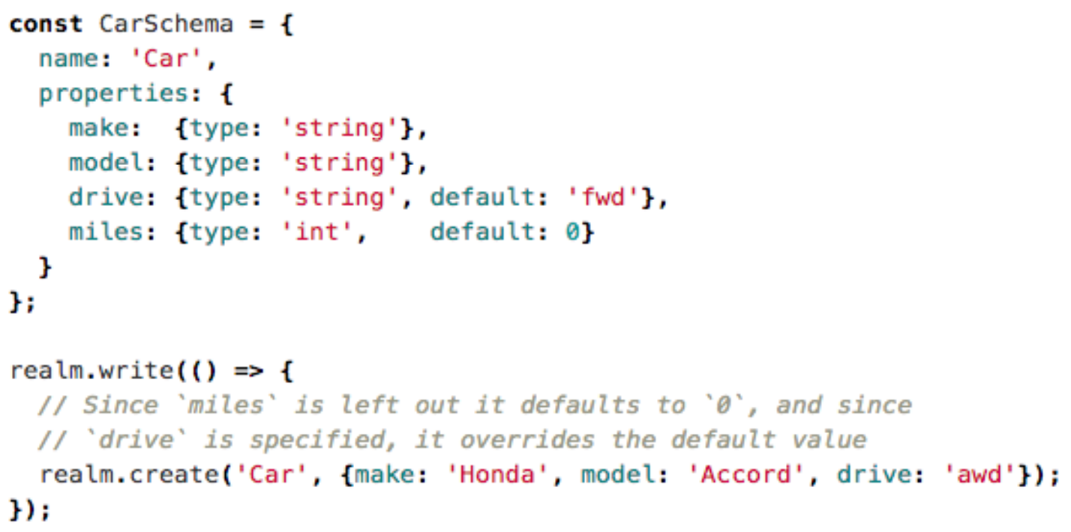
Default properties
Default property values can be specified by setting the default designator in the property definition.
To use a default value, leave the property unspecified during object creation

Slide 20
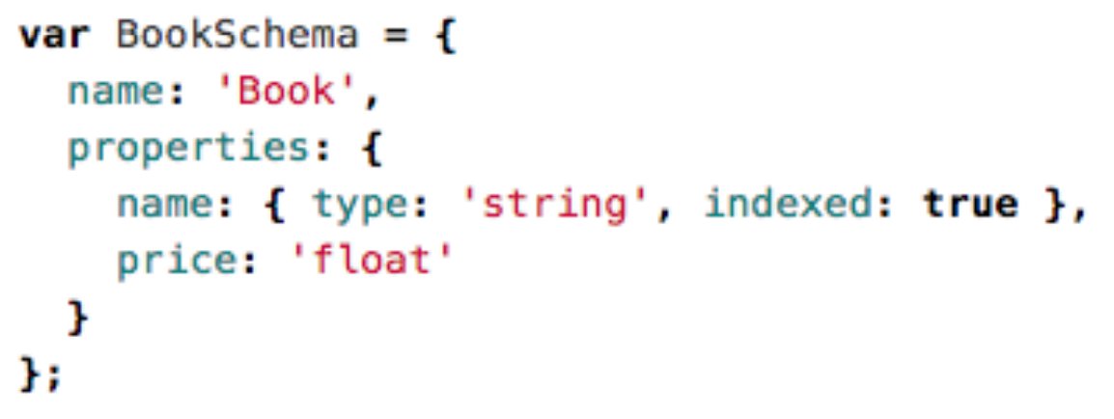
Indexed property
You can add an indexed designator to a property definition to cause that property to be indexed. This is supported for int, string, and bool property types:
Indexing a property will greatly speed up queries where the property is compared for equality at the cost of slower insertions

Slide 21
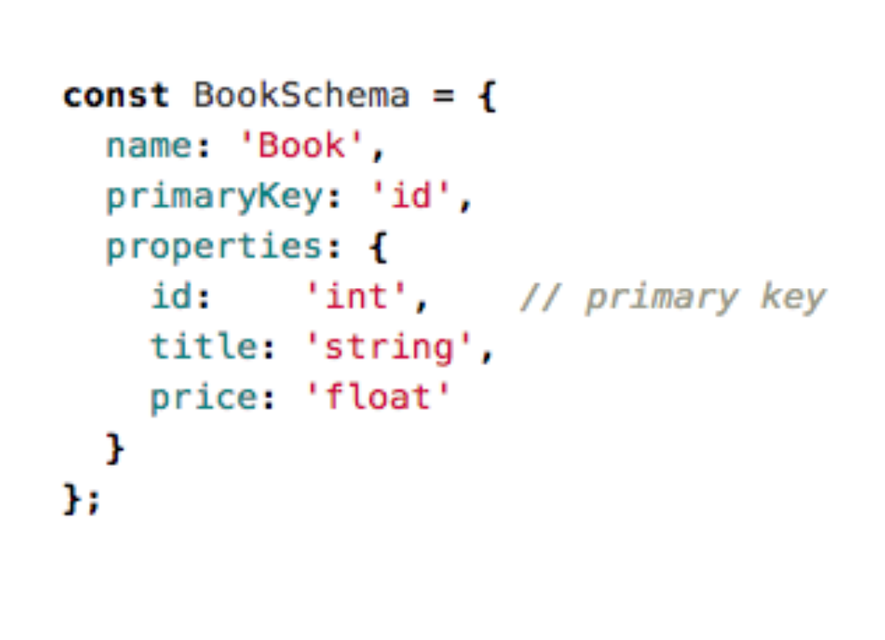
PrimaryKey property
You can specify the primaryKey property in an object model for string and int properties.
Declaring a primary key allows objects to be looked up and updated efficiently and enforces uniqueness for each value.
Once an object with a primary key has been added to a Realm the primary key cannot be changed.
Note that, Primary key properties are automatically indexed

Slide 22
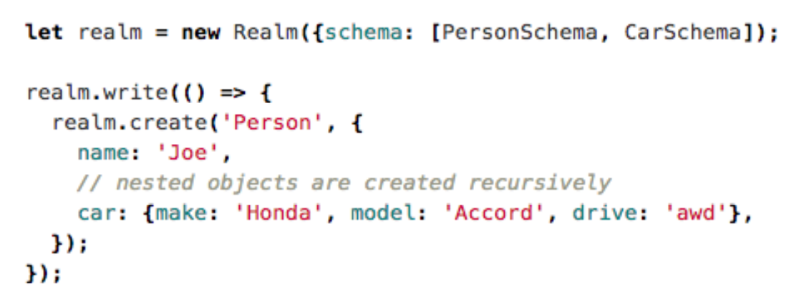
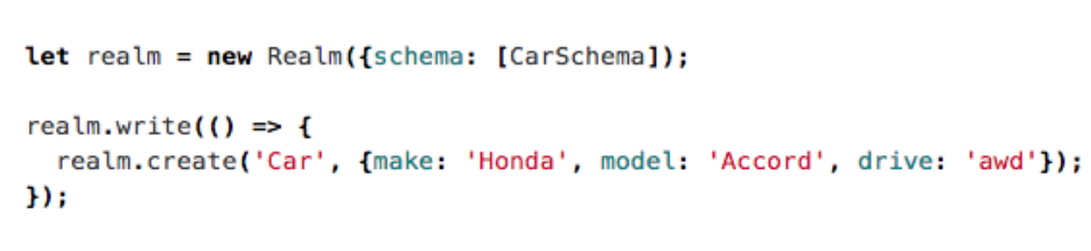
Writes: For creating objects
Objects are created by using the create method.
Nested Objects can create recursively by specifying JSON value of each child property

Slide 23
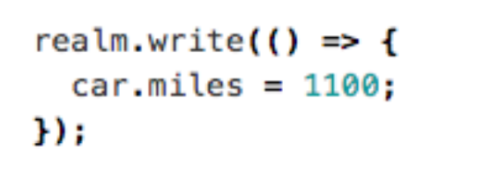
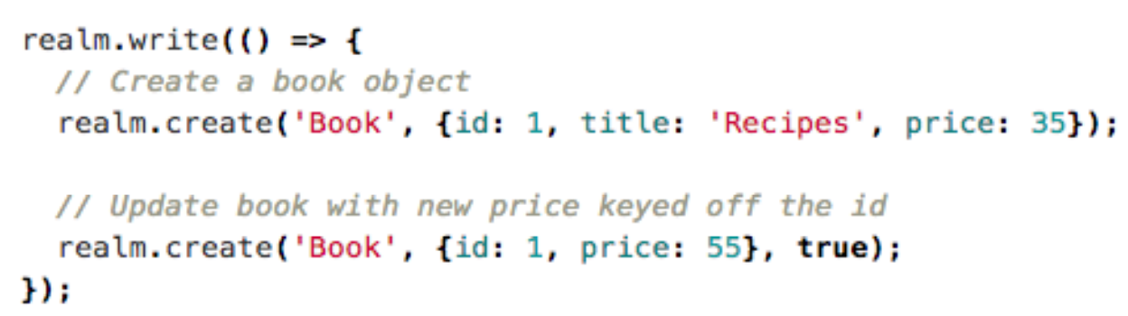
Writes: For updating objects
You can update any object by setting its properties within a write transaction
If the model class includes a primary key, you can have Realm intelligently update or add objects based off of their primary key values. This is done by passing true as the third argument to the create method:

Slide 24
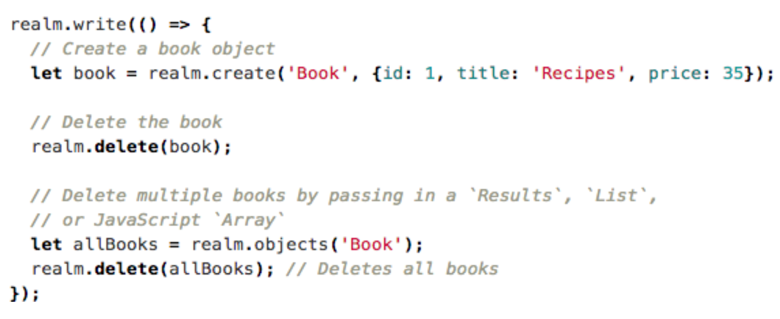
Writes: deleting objects
Objects can be deleted by calling the delete method within a write transaction

Slide 25
Queries
Queries allow you to get objects of a single type from a Realm, with the option of filtering and sorting those results.
All queries (including queries and property access) are lazy in Realm. Data is only read when objects and properties are accessed. This allows you to represent large sets of data in a performant way.
When performing queries you are returned a Results object. Results are simply a view of your data and are not mutable.

Slide 26
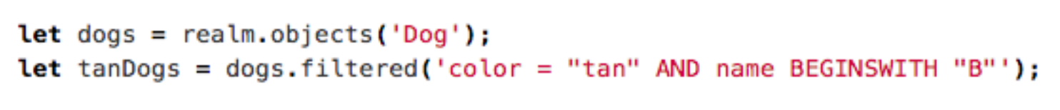
Queries: getting objects
The most basic method for retrieving objects from a Realm is using the objects method on a Realm to get all objects of a given type
You can get a filtered Results by calling the filtered method with a query string

Slide 27
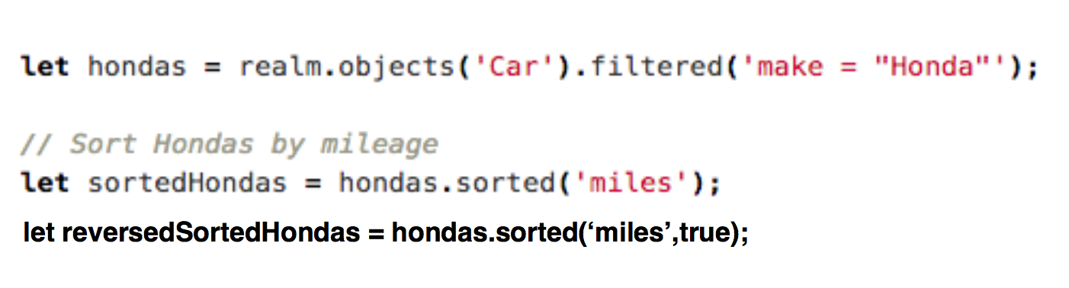
Queries: Sorting
Results allows you to specify a sort criteria and order based on a single or multiple properties.
For example, the following call sorts the returned cars from the example above numerically by miles:

Slide 28
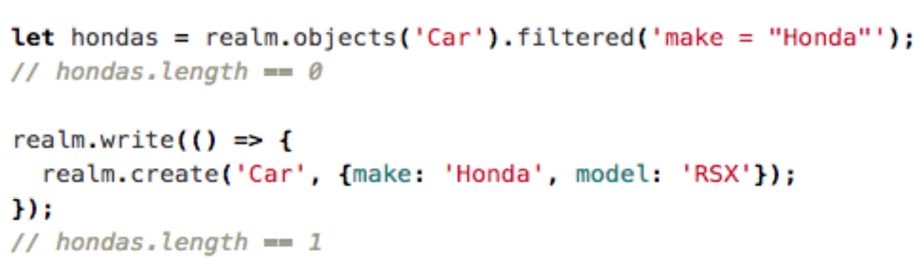
Auto-updated results
Results instances are live, auto-updating views into the underlying data, which means results never have to be refetched. Modifying objects that affect the query will be reflected in the results immediately.

Slide 29
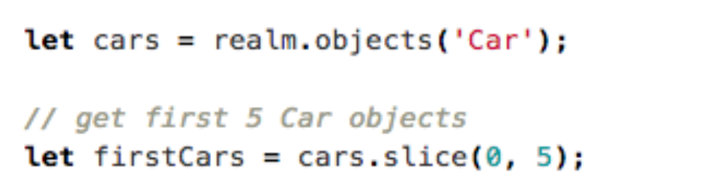
Size limiting
Realm are lazy, performing this paginating behavior isn’t necessary at all, as Realm will only load objects from the results of the query once they are explicitly accessed.
If for UI-related or other implementation reasons you require a specific subset of objects from a query, it’s as simple as taking the Results object, and reading out only the objects you need

Slide 30
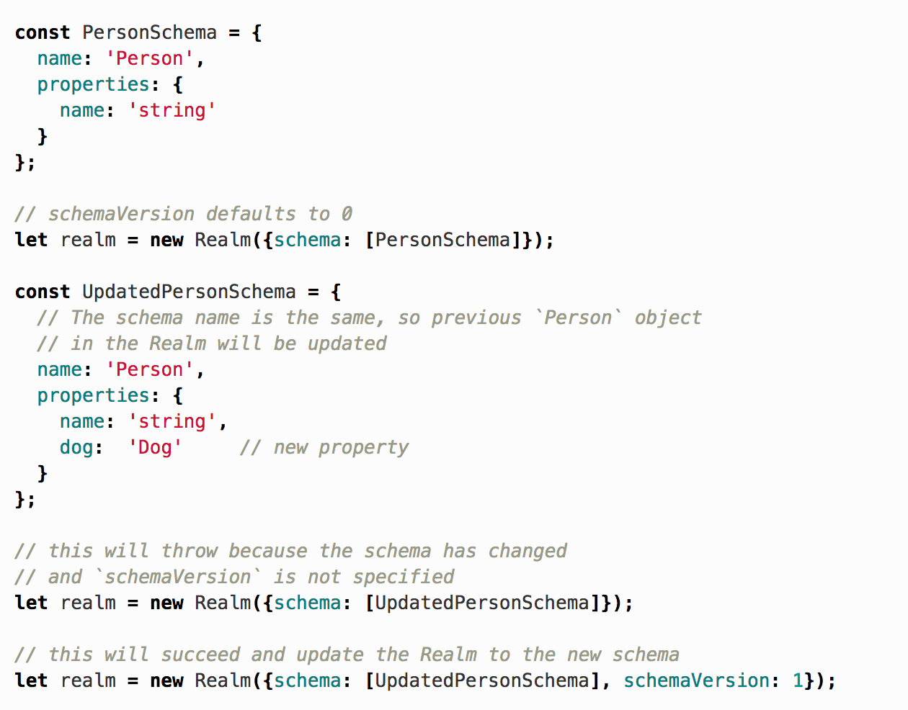
Schema version
Opening a Realm also have a schemaVersion property.
When omitted, the schemaVersion property defaults to 0.
You are required to specify the schemaVersion when initializing an existing Realm with a schema that contains objects that differ from their previous specification
If the schema was updated and the schemaVersion was not, an exception will be thrown

Slide 31
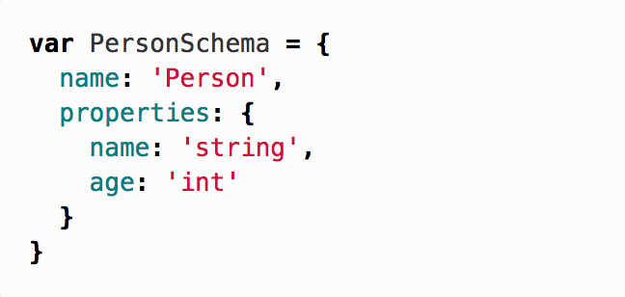
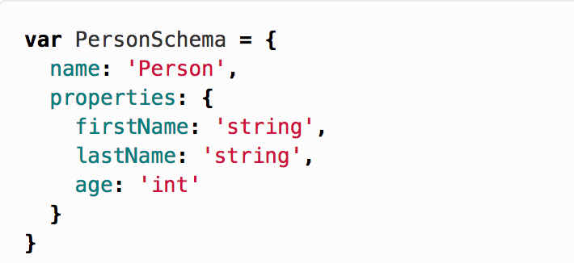
Migration
When working with a database your data model will most likely change over time. For example, suppose we have the following changes in Person model:

Slide 32
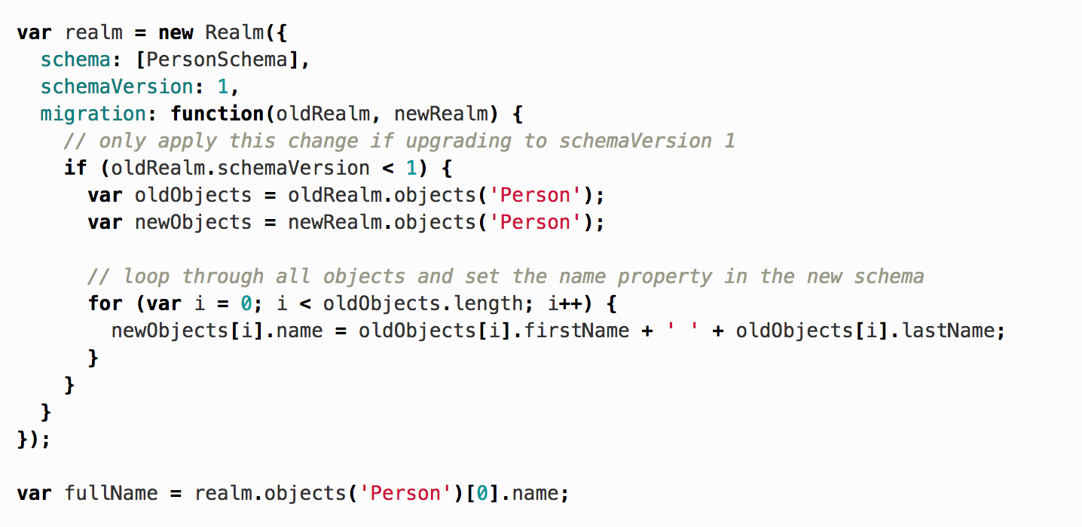
Migration
You define a migration and the associated schema version by updating the schemaVersion and defining an optional migration function.
Your migration function provides any logic needed to convert data models from previous schemas to the new schema.

Slide 33
Sync
Realm Mobile Platform (RMP) extends the Realm Mobile Database across the network, enabling automatic synchronization of data across devices.
In order to do this a new set of types and classes are provided that support these synchronized Realms; these new classes are additive to the existing Realm Mobile Database.

Slide 34
Sync: Users
The central object in the Realm Object Server is the Realm User (Realm.Sync.User) associated with a synchronized Realm.
A User can be authenticated to a shared Realm via a username/password scheme, or through a number of third-party authentication methods.
https://realm.io/docs/javascript/latest/index.html#sync

Slide 35
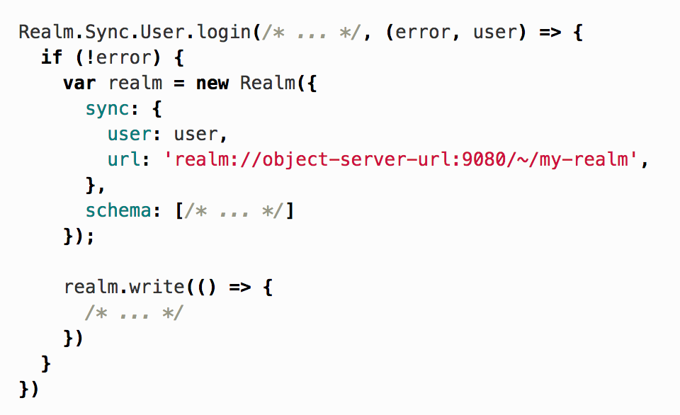
Synch

Slide 36
Realm API doc
Realm API Reference
https://realm.io/docs/react-native/latest/api/
Realm Tutorial
https://realm.io/docs/react-native/latest/#gettingstarted

